Slide 1

Final Project Detection & Disambiguation in Free Text Using GDELT Data
Johns, Michael
CSCI E-89 Deep Learning, Spring 2019
Harvard University Extension School
Prof. Zoran B. Djordjević

Slide 2
Overview
6 Notebooks
01-Introduction
02-GDELT Metadata
03-Crawl GDELT Data
04-Normalize GDELT Data
05-Finalize GDELT Data
06-GDELT Doc Model
Assessment & Next Steps

Slide 3
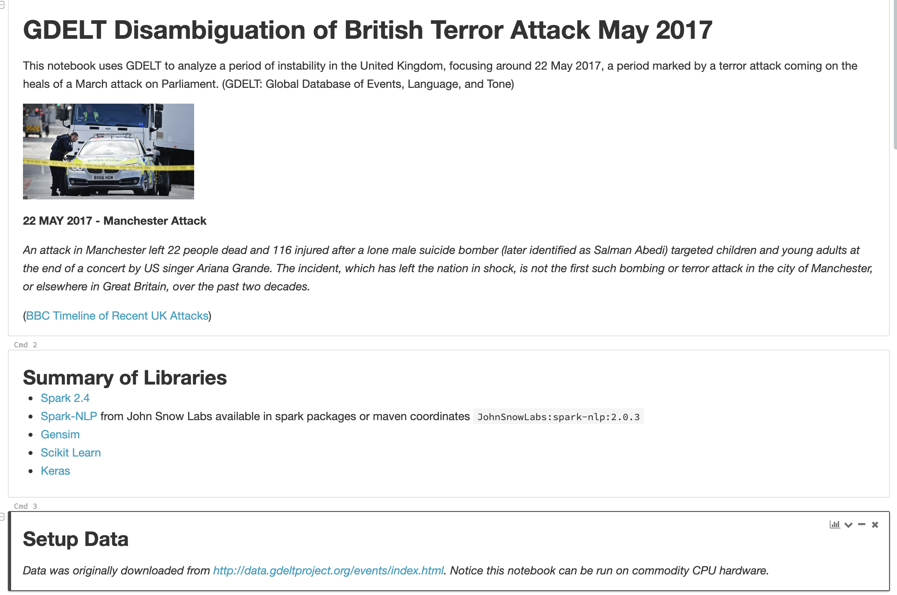
01-Introduction

Slide 4
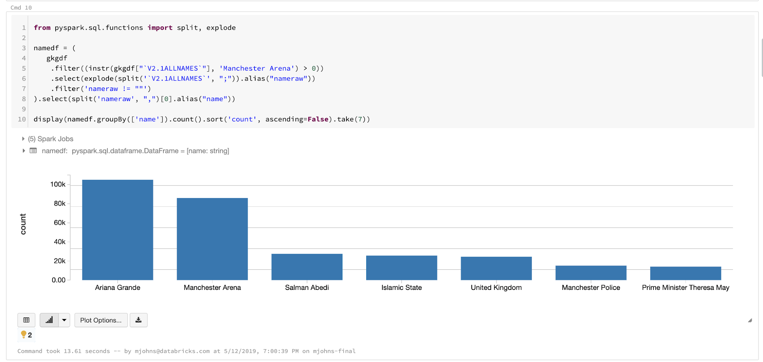
02-GDELT Metadata
Obtained Global Knowledge Graph data around the Manchester Attack (22-24 MAR 2017) -- 1M documents
Filtered to entries containing Location = ‘Manchester, UK’ -- 82K documents
Gathered list of urls to crawl from the subset
Libraries (Spark 2.4 on CPU Hardware)

Slide 5
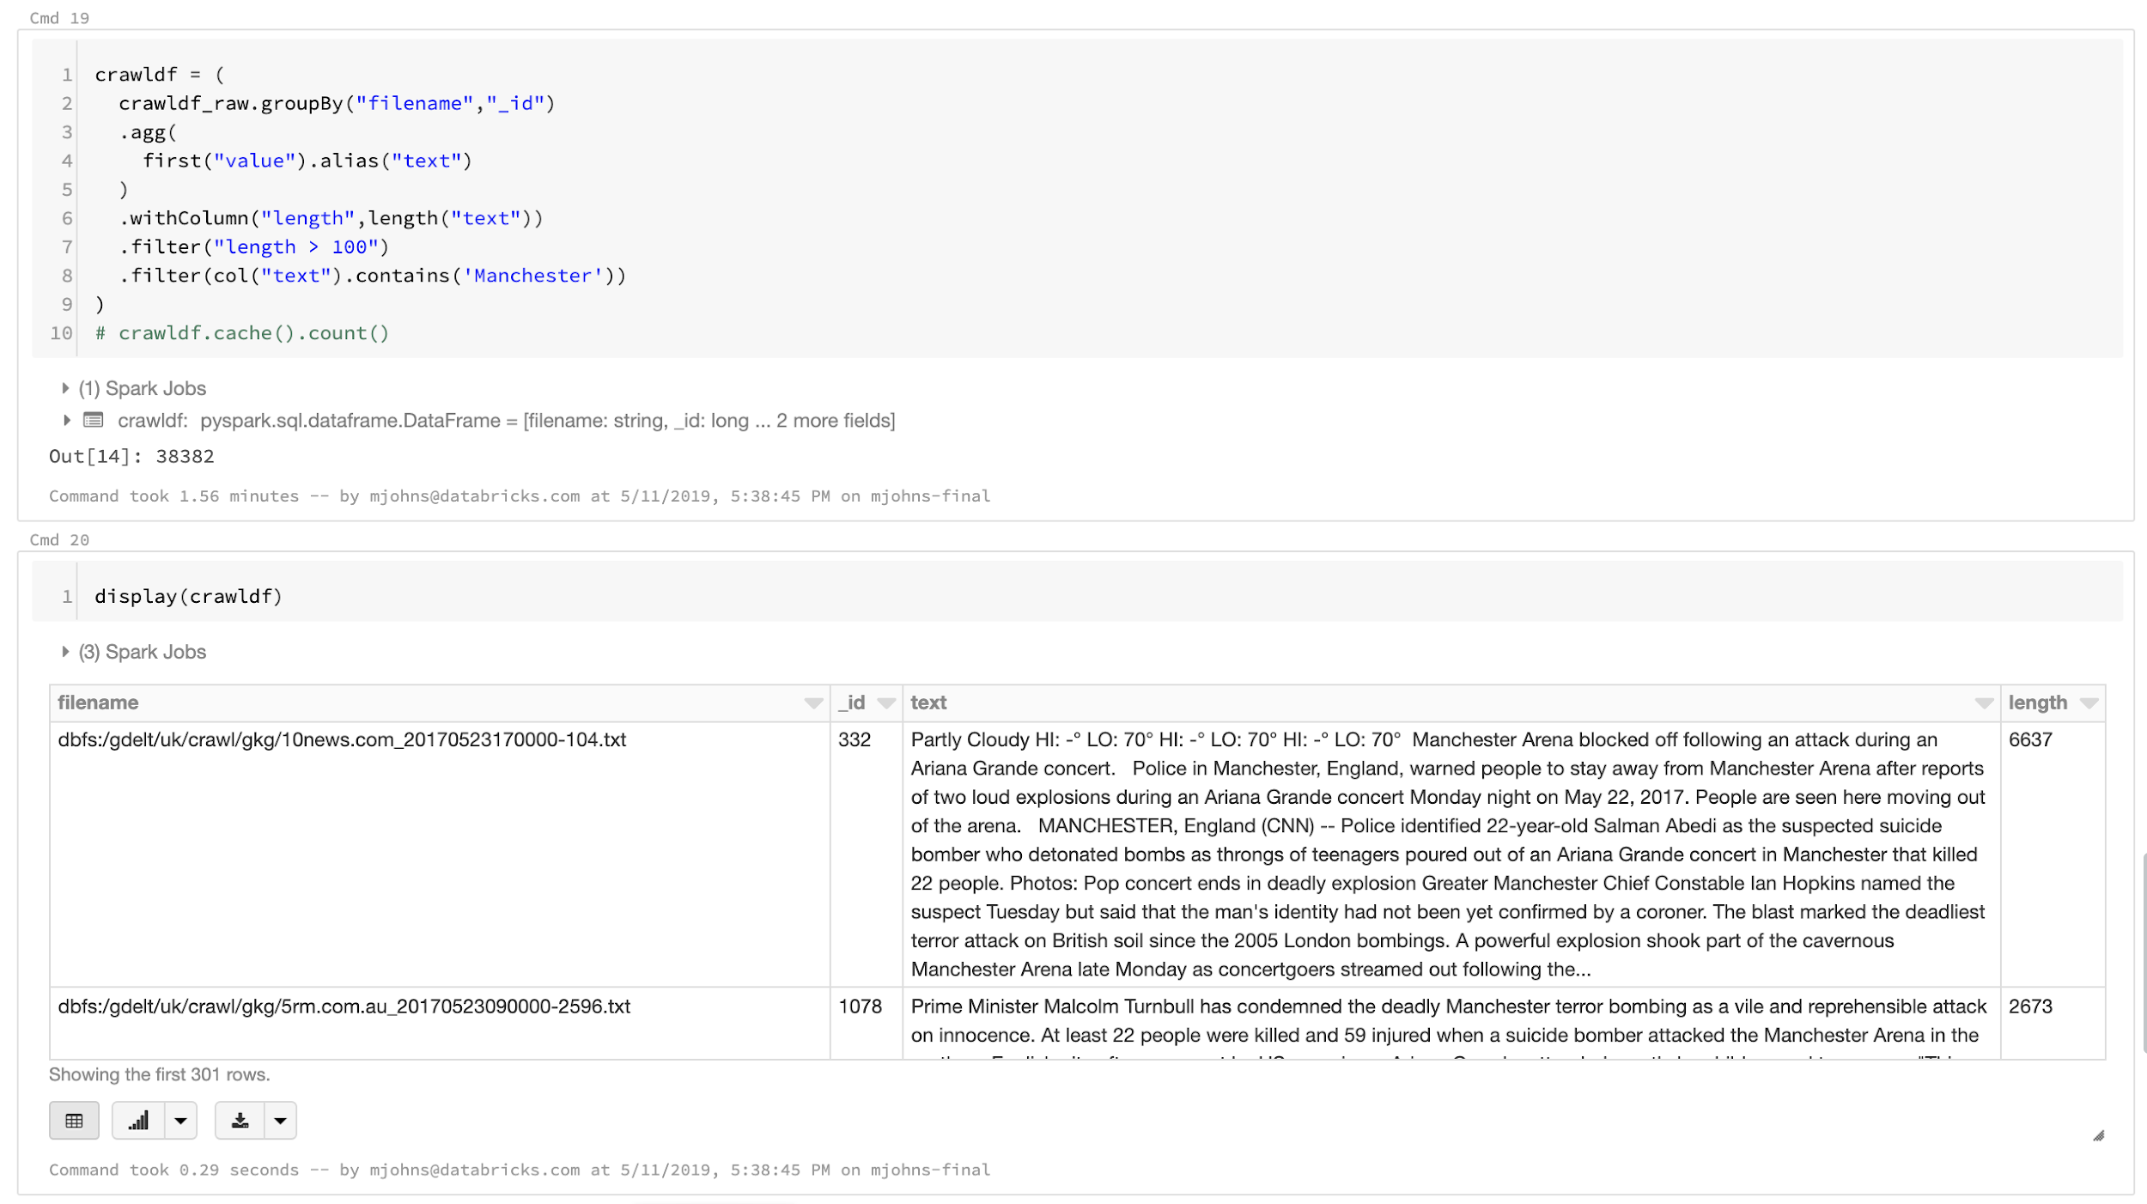
03-Crawl
Crawled the URLS
Cleaned up the content (resulted in drops based on criteria)
Libraries (Spark 2.4 on CPU Hardware)

Slide 6
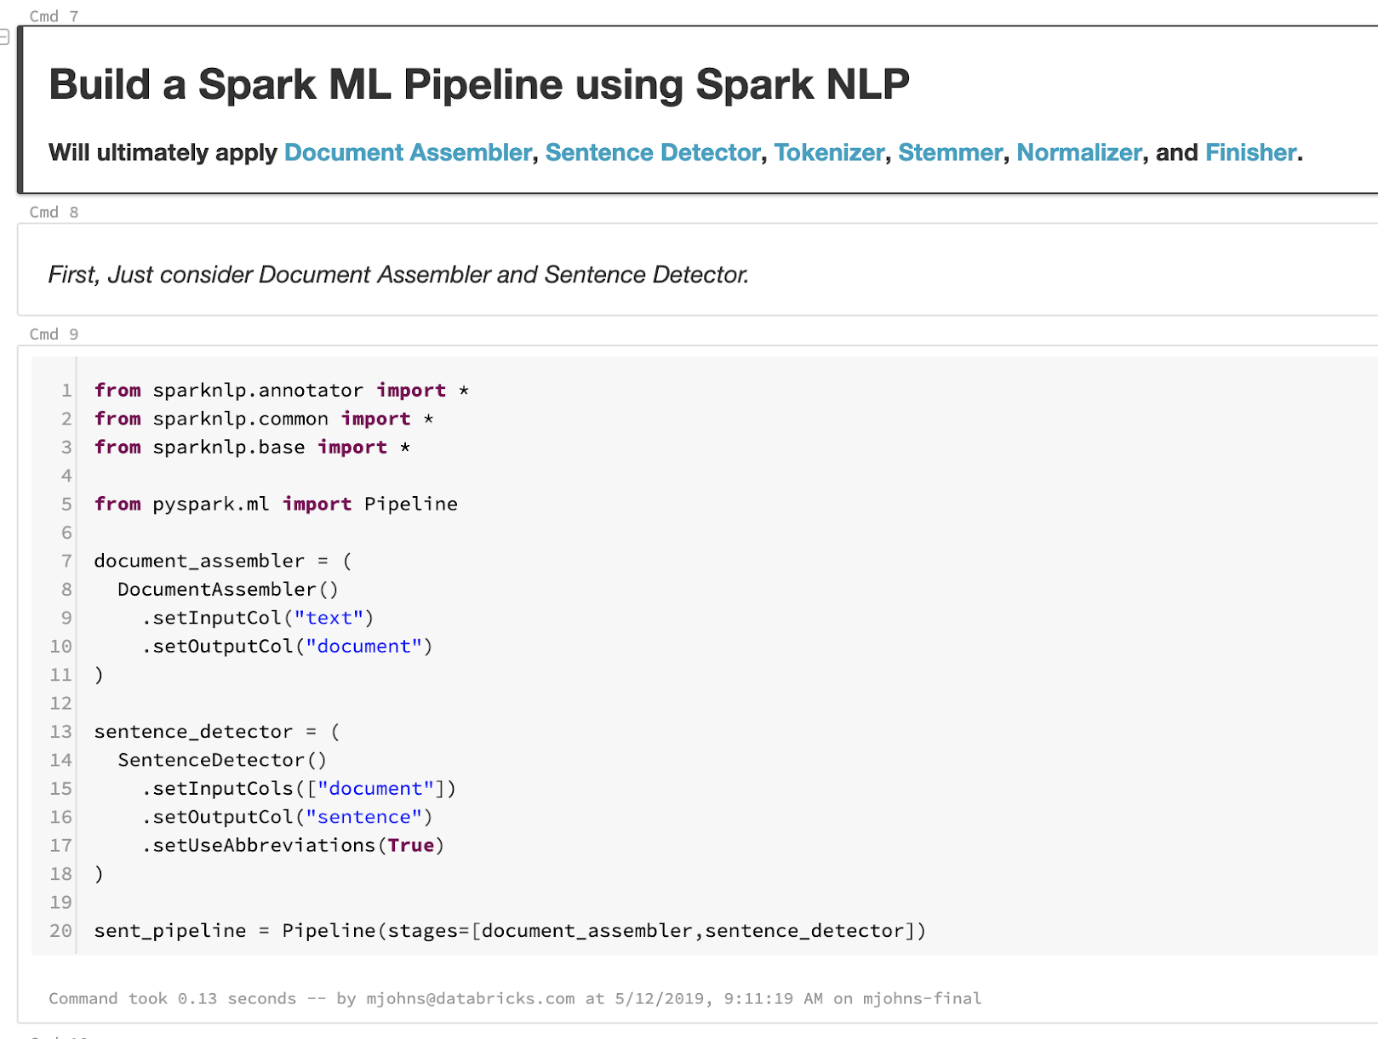
04-Normalize
Applied apply Spark-NLP Document Assembler, Sentence Detector, Tokenizer, Stemmer, Normalizer, and Finisher
Handled Doc Skew (small number with extremely high # sentences)
Handled Stop Words & Text2Vec
Also, did a number of additional operations such as PCA on “label” data that could be used in a future project
Libraries (Spark 2.4 + Spark-NLP on CPU Hardware)

Slide 7
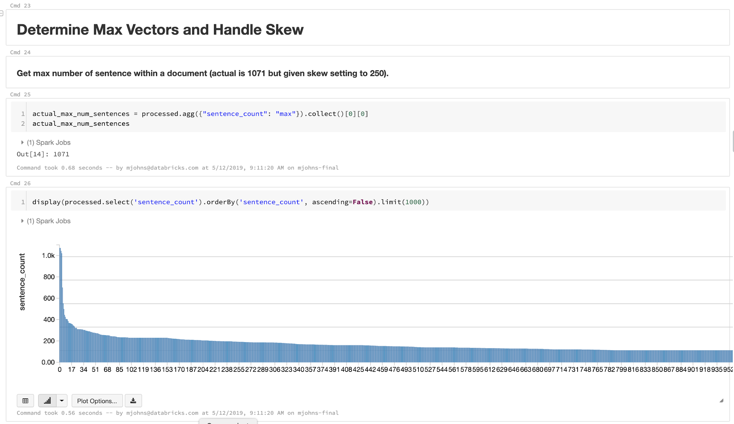
04-Normalize (cont.)
Applied apply Spark-NLP Document Assembler, Sentence Detector, Tokenizer, Stemmer, Normalizer, and Finisher
Handled Doc Skew (small number with extremely high # sentences)
...

Slide 8
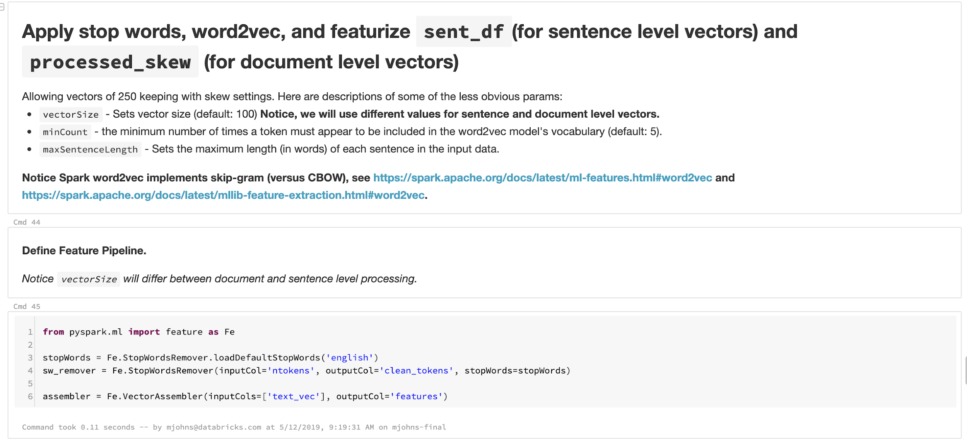
04-Normalize (cont.)
Applied apply Spark-NLP Document Assembler, Sentence Detector, Tokenizer, Stemmer, Normalizer, and Finisher
Handled Doc Skew (small number with extremely high # sentences)
Handled Stop Words & Text2Vec
...

Slide 9
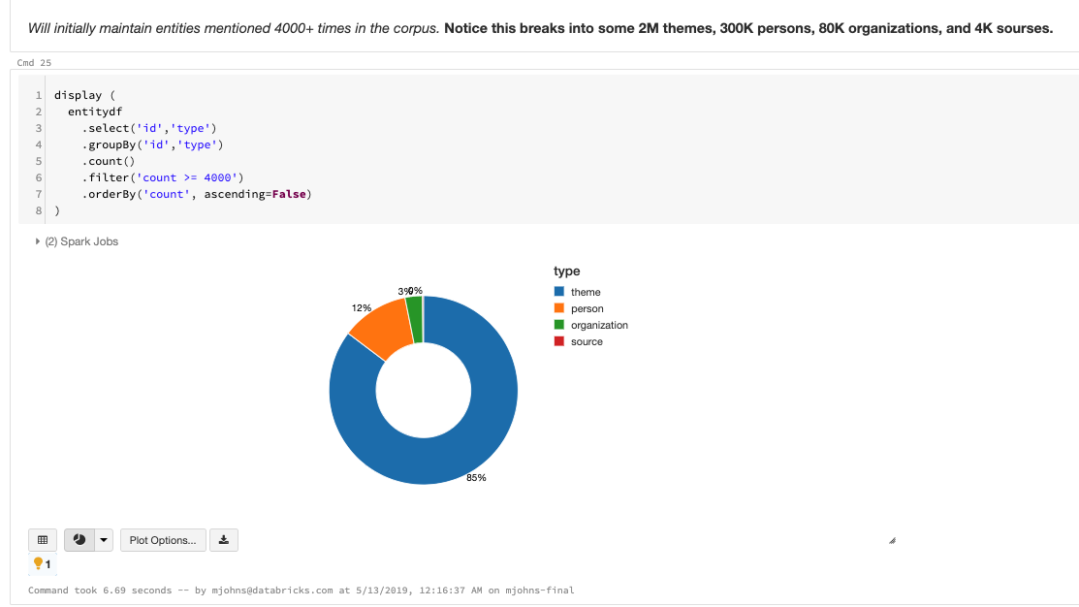
05-Finalize
To have labeled data, looked back at the Metatdata DataFrame and analyzed highly occurring entities (4000+ times) in the corpus
Found 2M themes, 300K persons, 80K organizations, and 4K sources
Focused on top ~150 themes and derived 10 categories based on those (using PCA)
Joined to Metadata DF
Parsed GKGRECORDID and V2SOURCECOMMON NAME from Crawl DataFrame Filenames which allowed it to be joined with MetadataDF as a Master DataFrame
Libraries (Spark 2.4 on CPU Hardware)

Slide 10
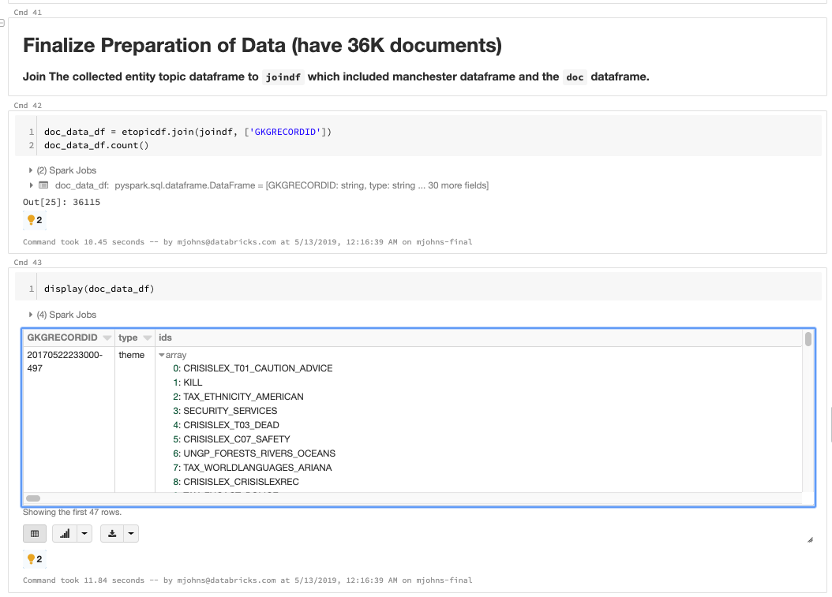
05-Finalize GDELT Data (cont.)
...
Parsed GKGRECORDID and V2SOURCECOMMON NAME from Crawl DataFrame Filenames which allowed it to be joined with MetadataDF as a Master DataFrame

Slide 11
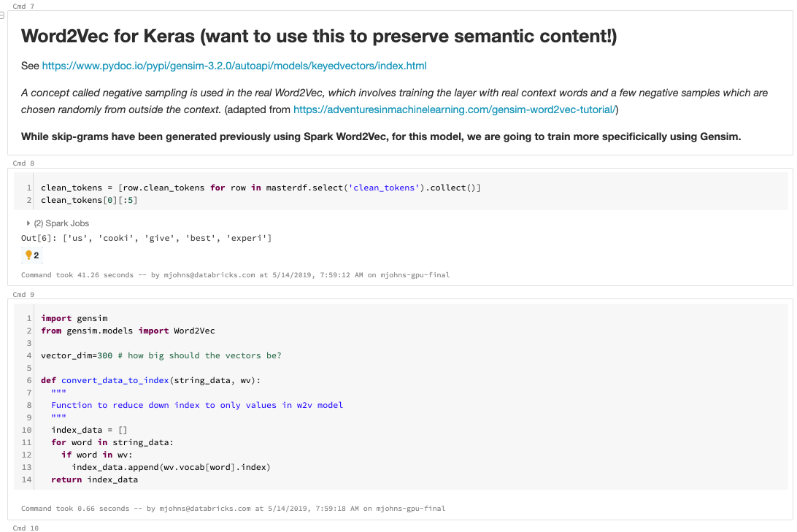
06-Doc Model
Built and Trained Word2Vec Model with Gensim
Built custom functions around W2V Vocab / Vectors
Used built-in functions for word similarities and distance
Ran t-SNE analysis with Scikit Learn against Vectors
top 1000 / bottom 1000 words)
Built and Trained custom Keras model to predict top_k words based on input word
Calculated and plotted accuracy for predicted vs actual results
top 20 / bottom 20 words
Libraries (Spark 2.4 + Gensim + Scikit Learn + Keras on GPU Hardware)

Slide 12
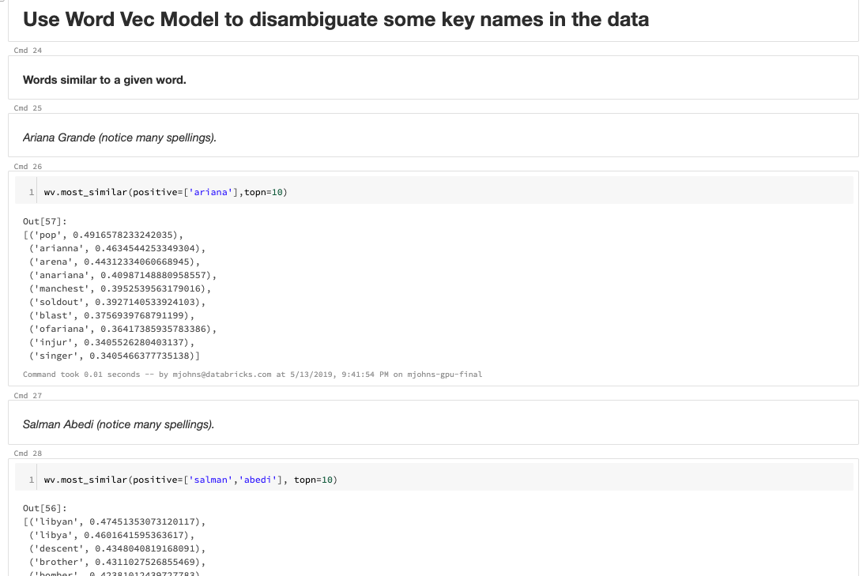
06-GDELT Doc Model (cont.)
Built and Trained Word2Vec Model with Gensim
Used built-in functions for word similarities and distance
...

Slide 13
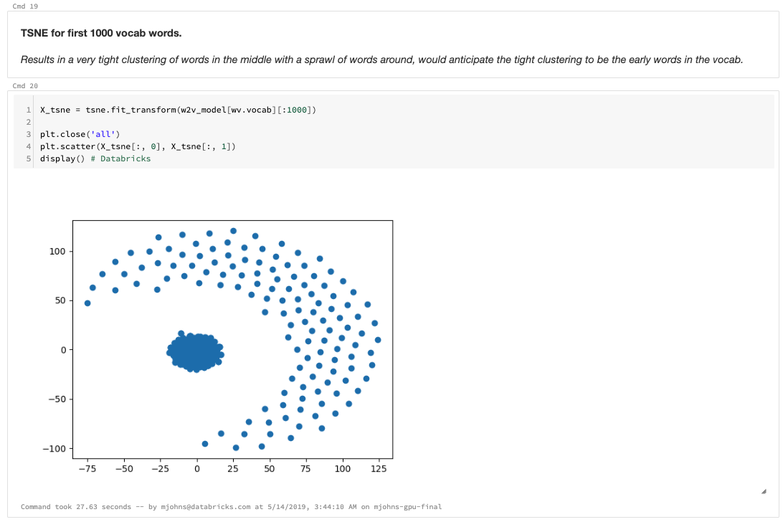
06-GDELT Doc Model (cont.)
Built and Trained Word2Vec Model with Gensim
Used built-in functions for word similarities and distance
Ran t-SNE analysis with Scikit Learn against Vectors
top 1000 words (results in a very tight clustering of words in the middle with a sprawl of words around, indicating strong vector distances for top words)
bottom 1000 words
...

Slide 14
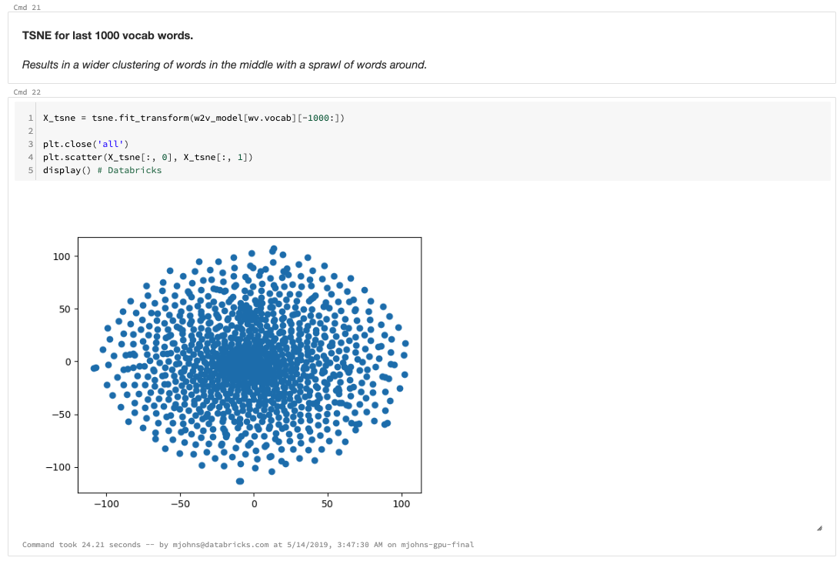
06-GDELT Doc Model (cont.)
Built and Trained Word2Vec Model with Gensim
Used built-in functions for word similarities and distance
Ran t-SNE analysis with Scikit Learn against Vectors
top 1000 words
bottom 1000 words (result in wider clustering of words in the middle with a sprawl of words around)
...

Slide 15
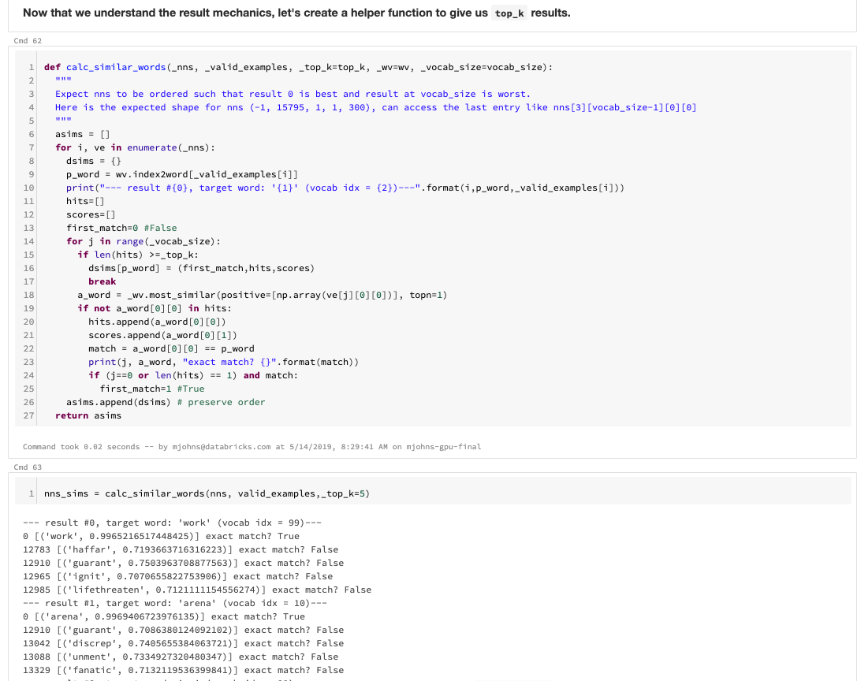
06-GDELT Doc Model (cont.)
...
Built and Trained custom Keras model to predict top_k words based on input word
Only similar word calculation from output shown for brevity
...

Slide 16
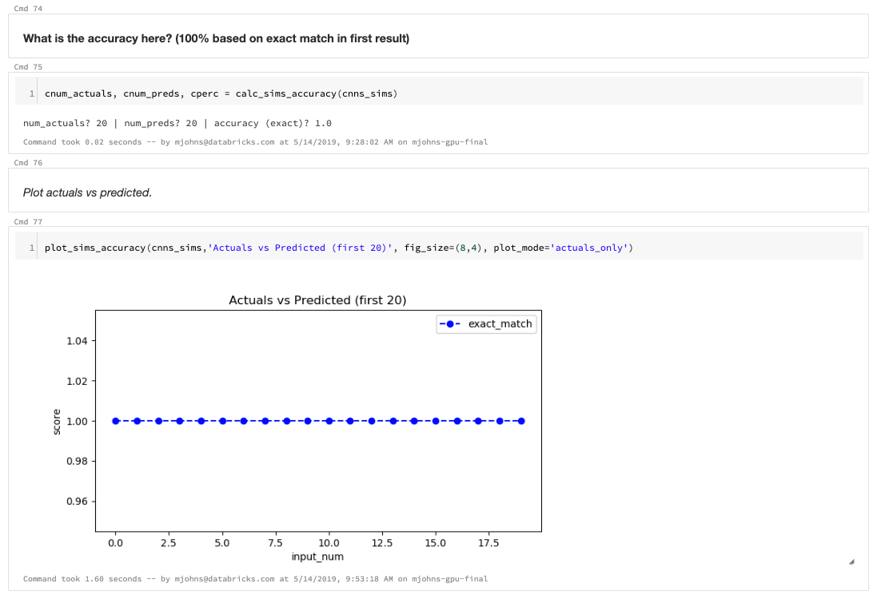
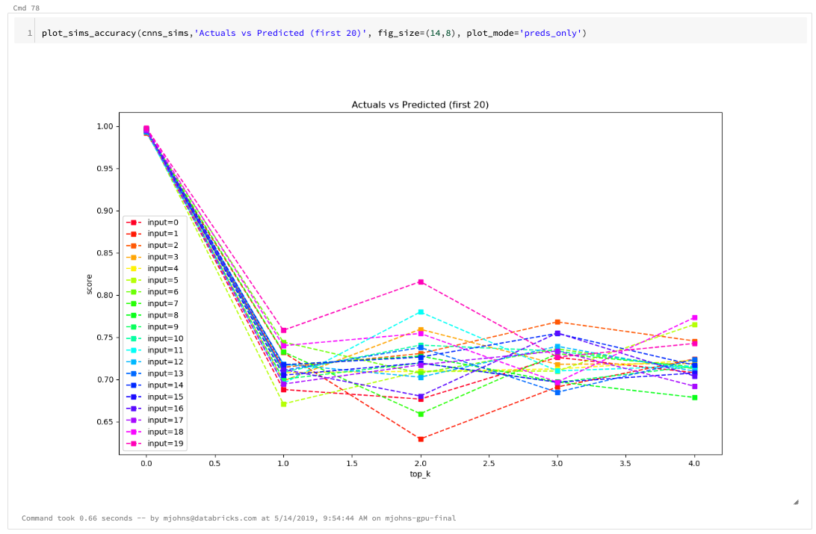
06-GDELT Doc Model (cont.)
...
Calculated and plotted accuracy for predicted vs actual results
top 20 words -- 100% exact match in first result; notice how strong first top_k vectors are of a match (compare to bottom 20 next).
bottom 20 words

Slide 17
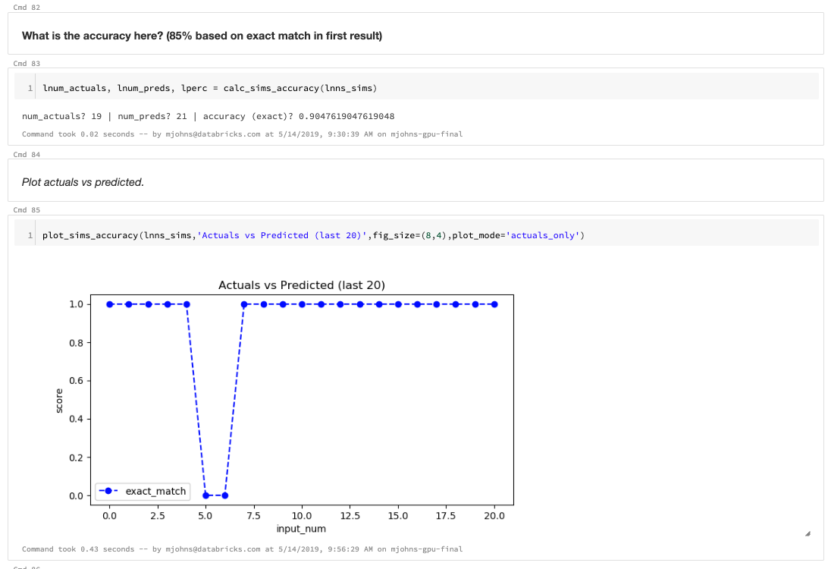
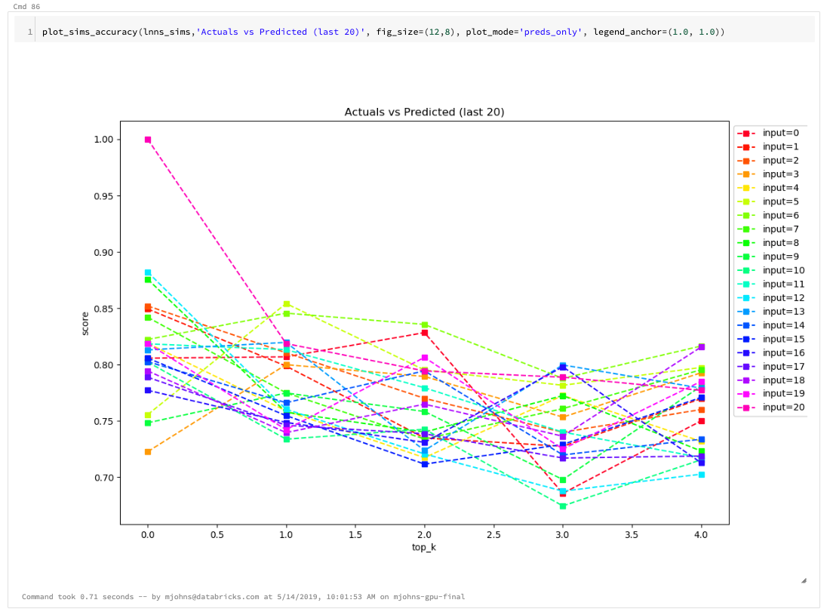
06-GDELT Doc Model (cont.)
...
Calculated and plotted accuracy for predicted vs actual results
top 20 words
bottom 20 words -- Notice accuracy drops to `.85` (wrt exact matching) indicating the latter part of the vocab is not as strongly connected (also, notice how cosine similarity scores are generally lower).

Slide 18
Next Steps
Assess sentences (versus docs) with existing Word2Vec & Keras models to see how vectors can be improved.
A follow on effort to build another Keras Model that can predict on the labeled data from the Metadata DataFrame:
Using PCA or LDA
Using generative, context-aware style model such as RNNs / LSTM
Could follow-on with additional techniques to disambiguate classic problems such as names and addresses in data. For example, extend approach on different data set, e.g. t-SNE for clustering of names in AMiner dataset (paper).

Slide 19
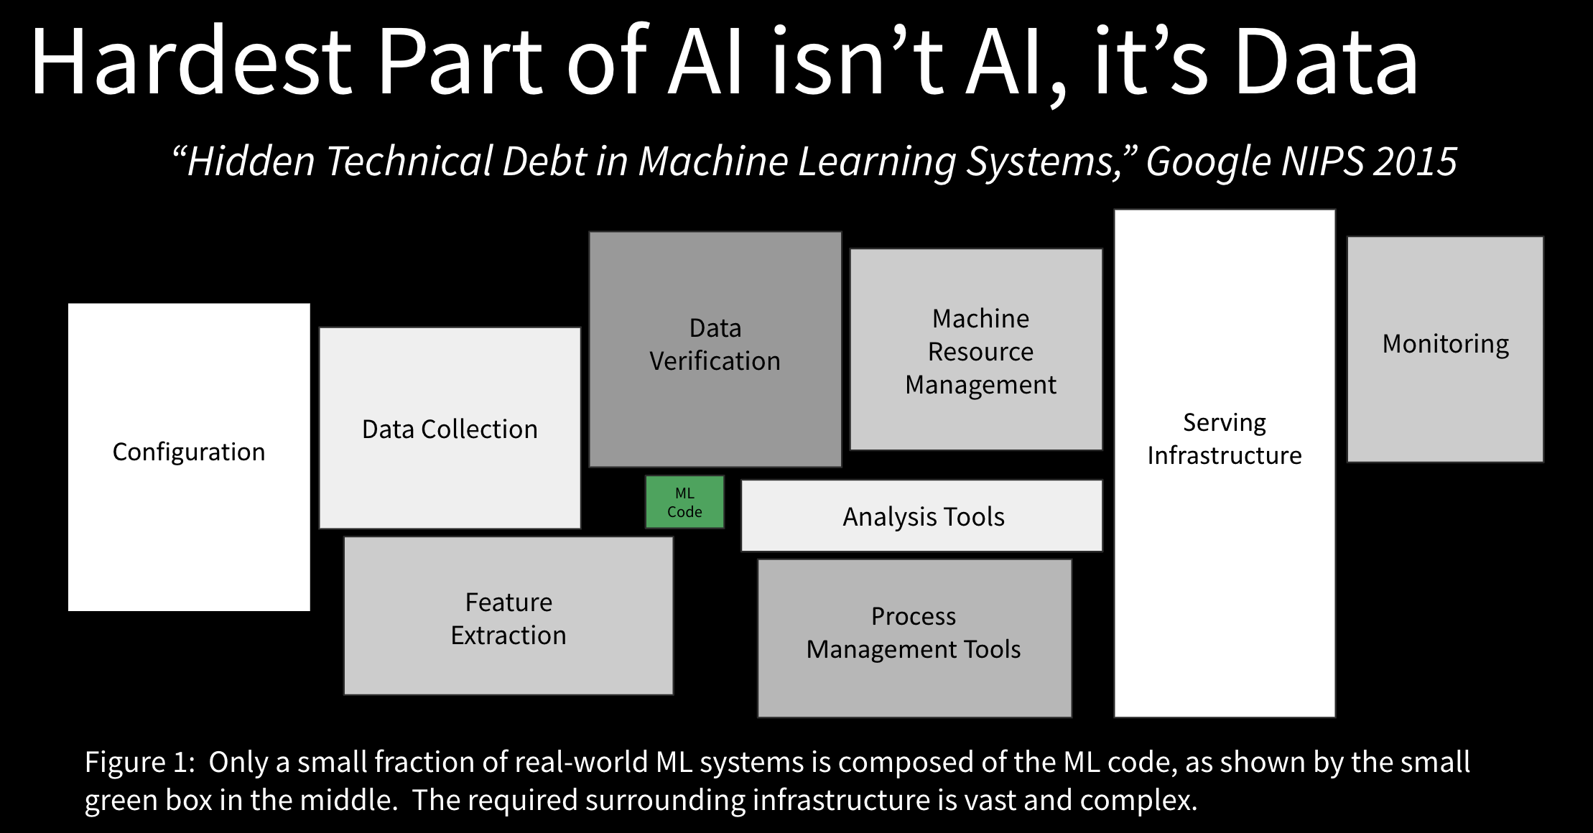

Slide 20
YouTube URLs, Last Page
Two minute (short): https://youtu.be/0EWWrrIVta4
15 minutes (long): https://youtu.be/zYKnljbv9zM

